Slide 1
…Meanwhile, In the Americas
Who will survive first contact?
(Which group is better able to stand against the Europeans?)

Slide 2
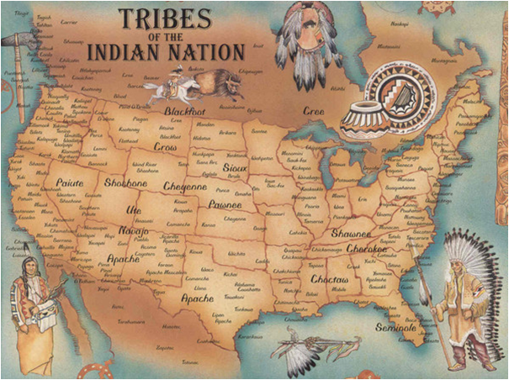
The Americas were not empty!
When Europeans “discovered” the Americas, they “discovered”
a land where people had been living already for thousands of years.

Slide 3
Mayan Confederation

Slide 4
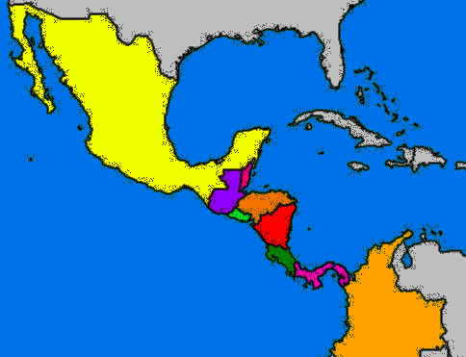
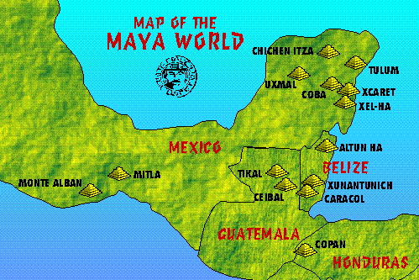
Maya in Central America
Location: Yucatan Peninsula in Central America

Slide 5
Maya in Central America
Government: There is no central or single ruler of the Mayan Civilization. Each city has its own ruler and they agree to get along with the other cities/rulers. If one city needs help, the other cities agree to help it. This is called a Confederation.

Slide 6
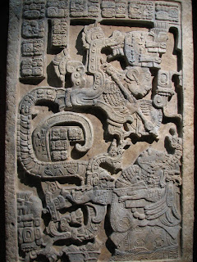
Maya in Central America
Religion: Worshipped many, many gods. Human sacrifice was a big part of their worship. Sacrifice victims were could be captured enemies of the Maya or a member of the Mayan population. Sacrifices were a way of making contact with the Gods and feeding their appetites. A ball game was also part of ritual worship.

Slide 7
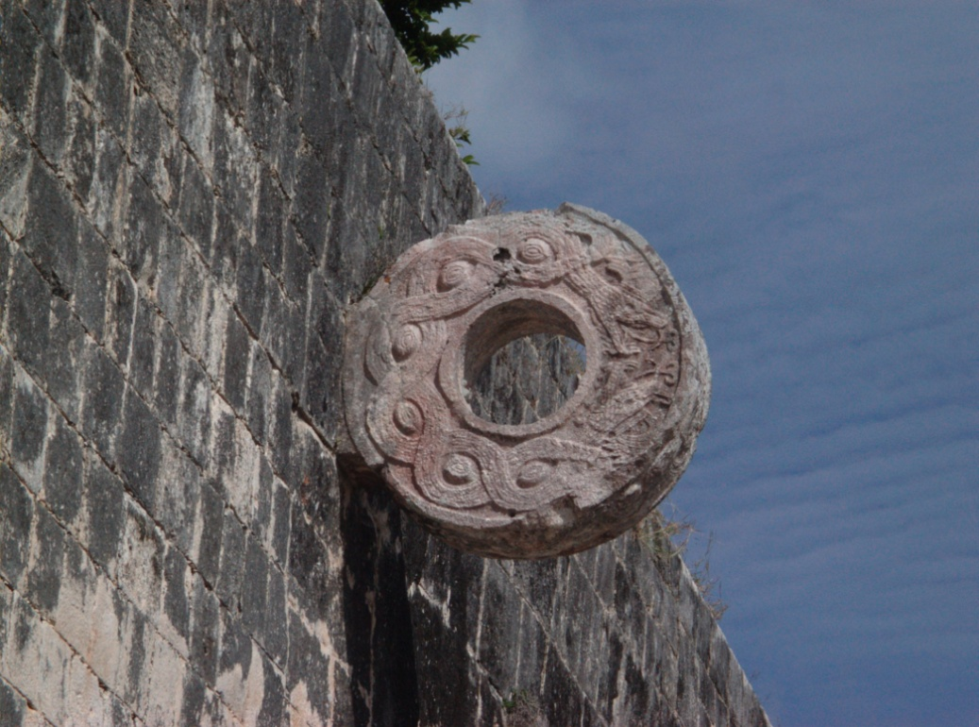
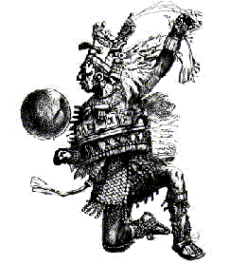
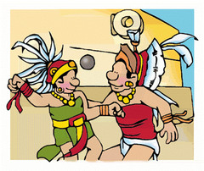
Maya in Central America

Slide 8
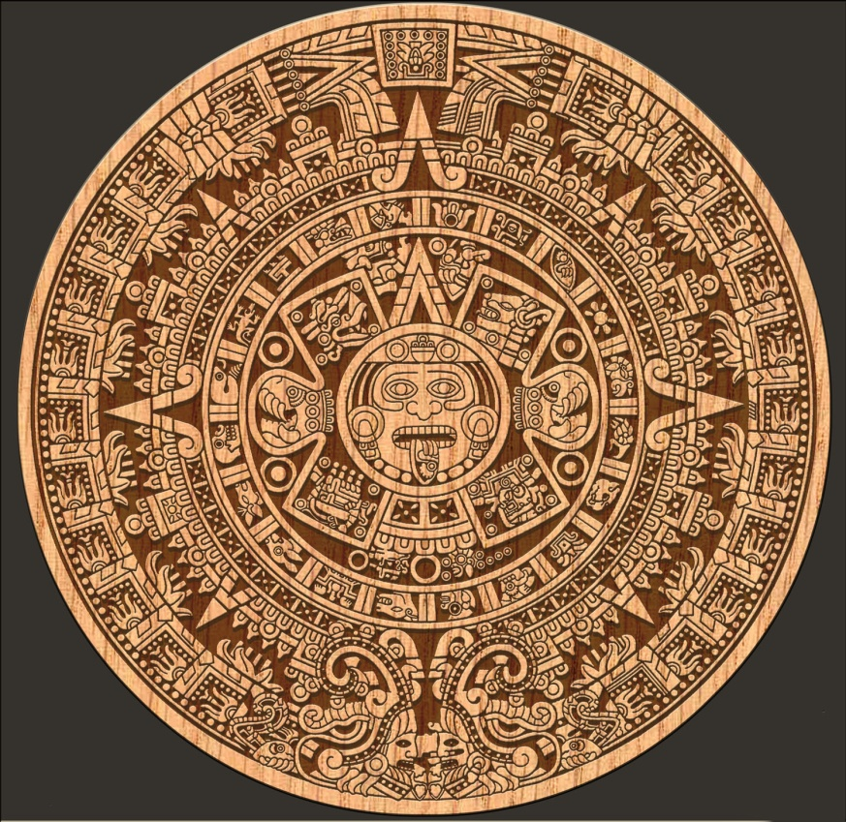
Maya in Central America
Science: Remember what everyone said about December 21, 2012?
Maya had intricate knowledge of astronomy and mathematics. They understood the movement of the stars and the rotation of planets. Science and religion were very closely related.
1 year = 365 days
1 year = 18 months
1 month = 20 days (+5 unlucky days)

Slide 9
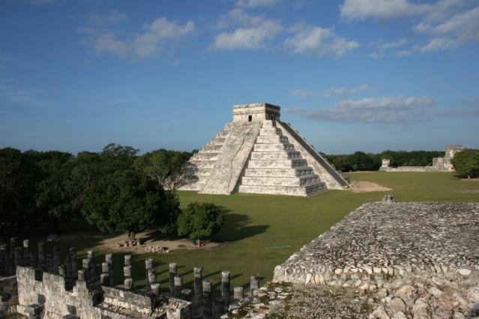
Maya in Central America
At one time of European arrival, the Mayan population was close to 2 million people. The people either lived in the great cities or in smaller farming villages. The people were expert in carving stone, obsidian, and jade. Most well known city for tourists today is Chichen Itza (located in Mexico). Maya were
driven by the need to have sacrifices to conquer and capture people. If they couldn’t capture enemies, they would be sacrificed. Thus, they had a good military.

Slide 10
Aztec Empire

Slide 11
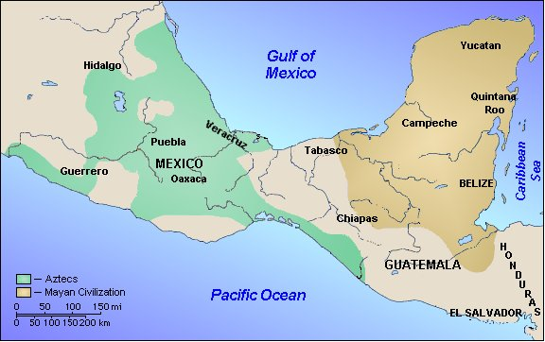
Aztec in Mexico
Location: Mexico Valley

Slide 12
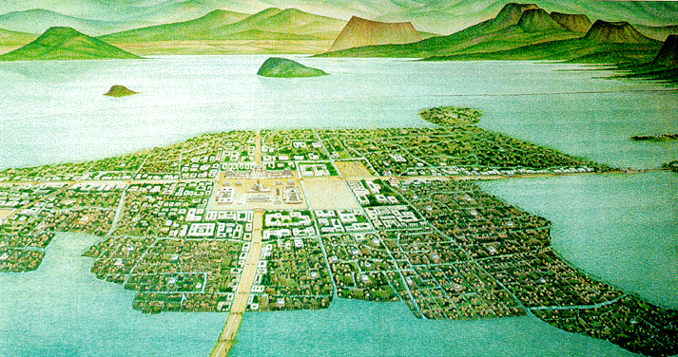
Aztec in Mexico
Government: The center of the Aztec Empire is the city Tenochtitlan (built on a marsh in Lake Texcoco). All other cities in the Aztec Empire answered to and paid tribute to this city. Cities
refused to stay in line were threatened with military force.

Slide 13
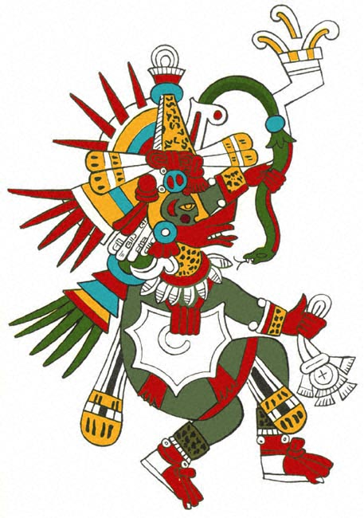
Aztec in Mexico
Religion: Aztec also believed in many Gods (they are polytheists) and they also had human sacrifices to keep the Gods happy. For example, feeding the sun god blood would make sure the sun came up every morning. For Aztecs, they way they died determined where they went after death. The Aztecs were waiting for the return of one of their Gods – Quetzalcoatl – when the Europeans arrived.

Slide 14
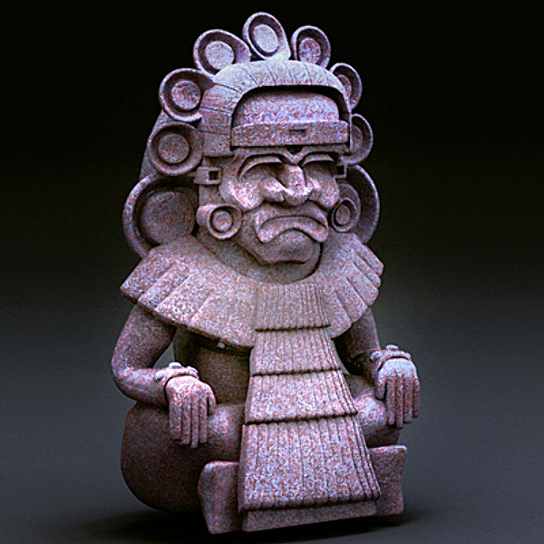
Aztec in Mexico
Science: The Aztec were also advanced in astronomy and math. However, they are better known for their advancements in medicine. In fact, the Aztec had the best medicine of all the Native American cultures at the time. Their medicine was based on herbal remedies.

Slide 15
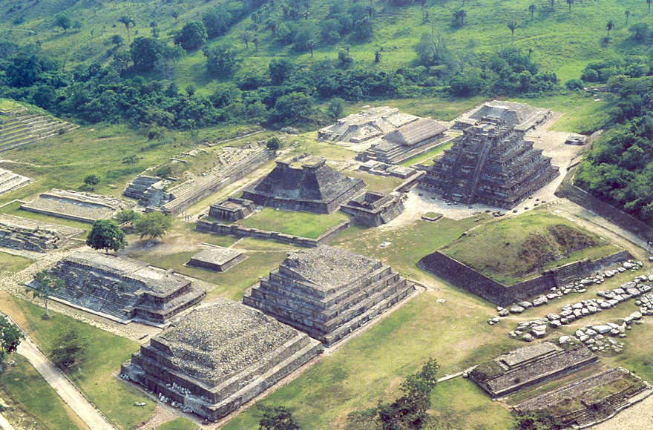
Aztec in Mexico
Much of the Aztec economy was based on tribute paid by other cities (of the Aztec and non-Aztec they conquered) to Tenochtitlan. When those paying tribute tried to rebel, the Aztec sent in their army to bring them back in line. Most of the army was made of common people – non-professional soldiers.
Education was fairly universal – to a point – among the Aztec. Children went to school and learned the basics of their culture. All
children went to school, regardless of what caste you belonged to.
Aztec cities were generally pretty clean and most Aztec homes appear to have some sort of a steam bath.

Slide 16
Inca Empire

Slide 17
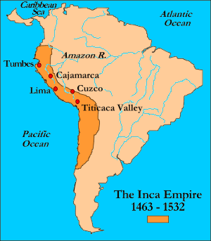
Inca in South America
Location: Peru, South America
Mostly in the Andes Moutains

Slide 18
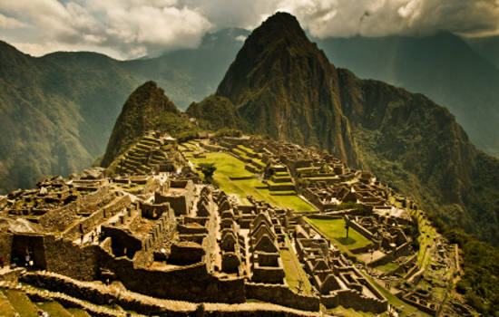
Inca in South America
Government: The Inca Empire was the largest Native American Empire before the Europeans arrived. The capital city was Cuzco, located on Lake Titicaca. At its largest, the Incan King ruled over nearly 12 million people. Under the Emperor was a council
of 4 men (his advisors). The empire was split into 4 smaller sections with a governor over each who answered directly to the king.
Machu Picchu

Slide 19
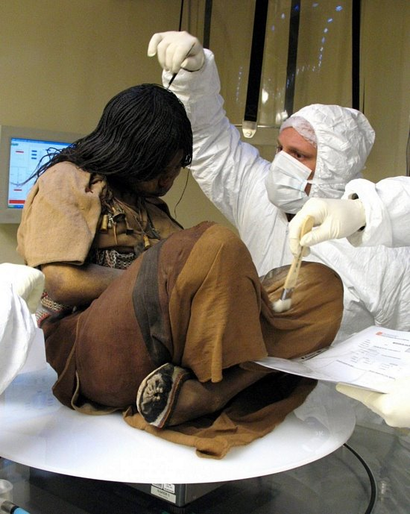
Inca in South America
Religion: Like the others, the Inca were polytheist. The Inca believed they were direct descendants from the sun and moon – their ancient father and mother. The Inca also had human sacrifice, but not to the same extent and brutality of the Aztec and Maya.
Story of the Ice Maiden – 15 years old is 500 years old.

Slide 20
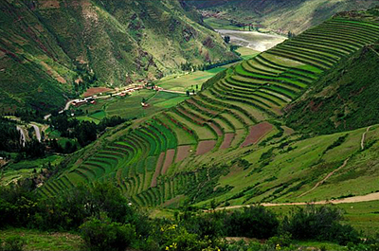
Inca in South America
While the Inca Empire was the largest of its kind during the time, it lacked some basic technology that you might expect. Though they did have an intricate tax system, they did not have a system of writing. The Inca did not use the wheel for transportation.
Most of the Incan Empire was located in the Andes Mountains. In order to produce enough food to support themselves, Incan farmers used terraced agriculture – cutting into the sides of the mountains so they could grow their crops.
Living in the mountains meant the empire was easily defendable, and the Inca had a very large army (because they had a very large population).

Slide 21
Quiz
We know the Native Americans and the Europeans are going to come in contact with each other soon. We also know (or at least can guess) the outcome of that contact.
Based on what we talked about today, which group do you think was able to hold out the longest against the Europeans? Which group do you think was conquered fastest? Use evidence from the lecture to support each of your claims.

Slide 22
Quiz
2 Paragraph Essay
1st Paragraph – Which group was able to hold out the longest against the Europeans?
1st sentence – Thesis/Claim
2nd - 4th sentences – Evidence from lecture supporting your thesis/claim (at least one evidence from the lecture)
5th sentence – Conclusion
2nd Paragraph – Which group was conquered the fastest?
1st sentence – New Thesis/Claim
2nd – 4th sentences – Evidence from lecture supporting your thesis/claim (at lease one evidence from the lecture)
5th sentence - Conclusion

